Slide 1

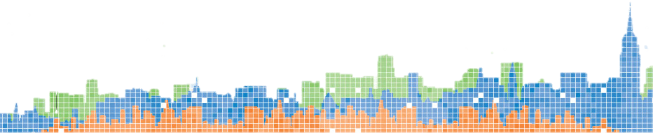
SONYC – Sounds of New York City Hardware/Sensor Design & Data Collection GX 9004.005
Charlie Mydlarz
cmydlarz@nyu.edu

Slide 2
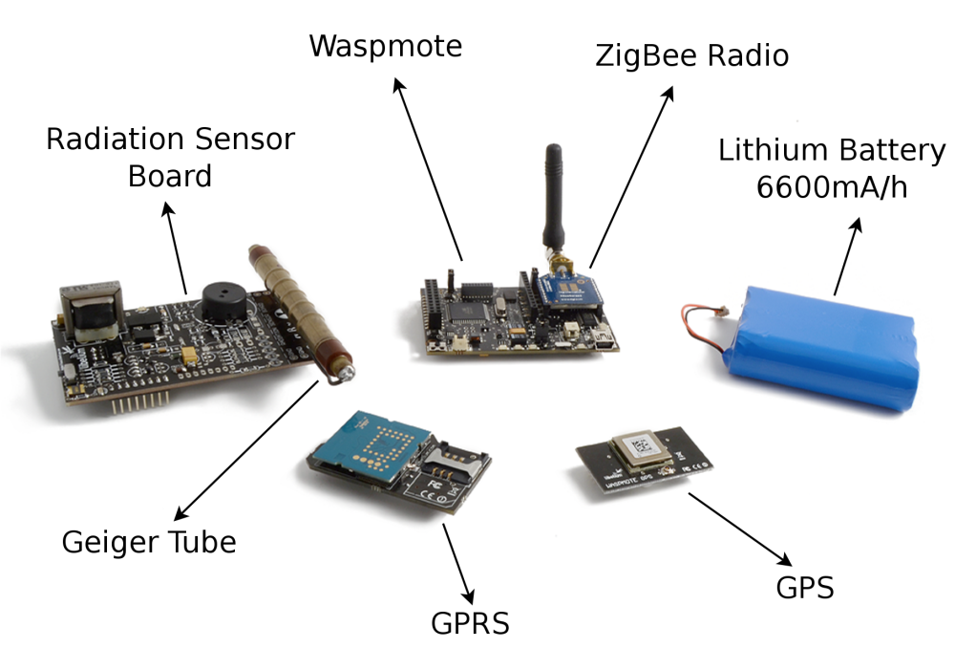
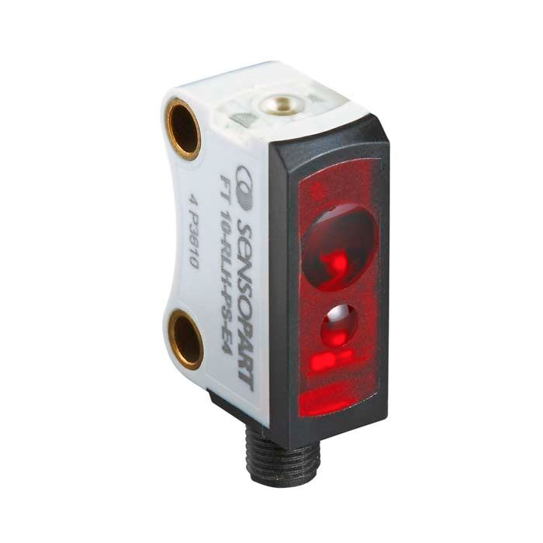
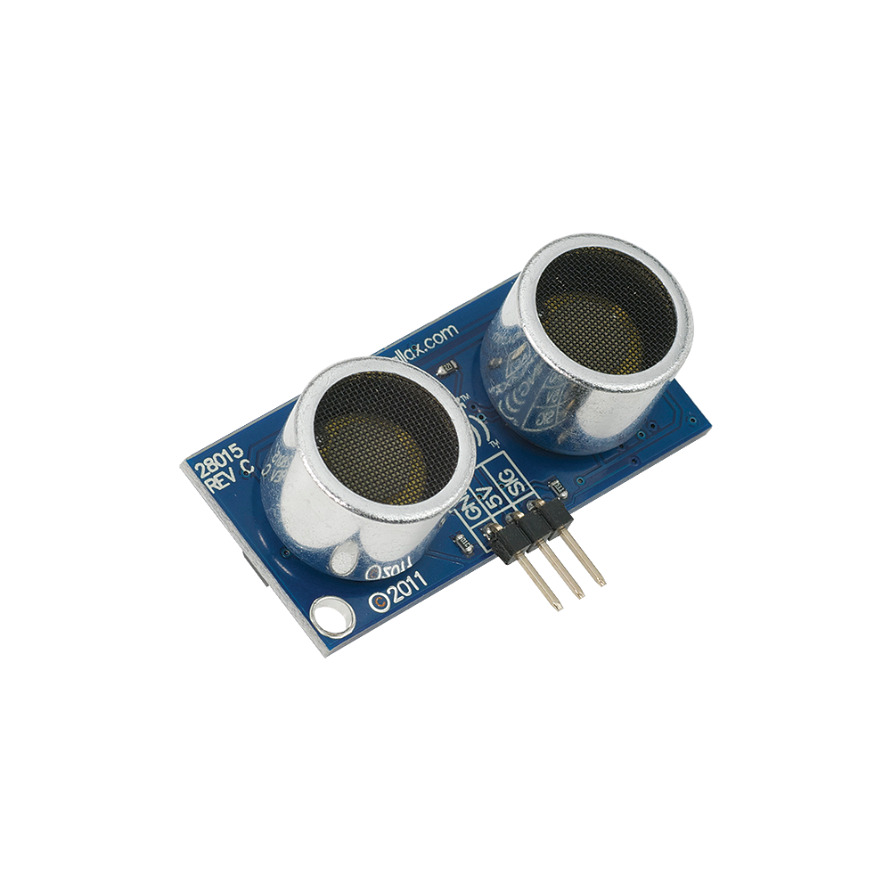
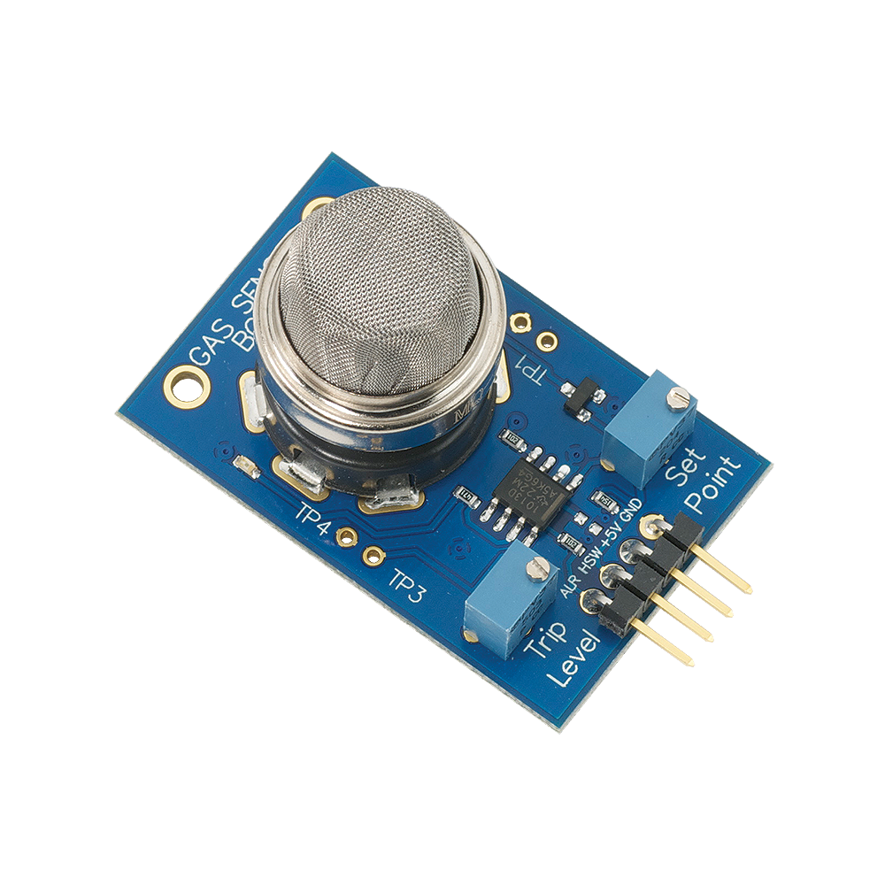
Soundscape fundamentals Sensors & transducers
Sensor - a device that converts some physical phenomenon into an electrical signal
Transducer - a component that converts one type of energy into another type of energy

Slide 3
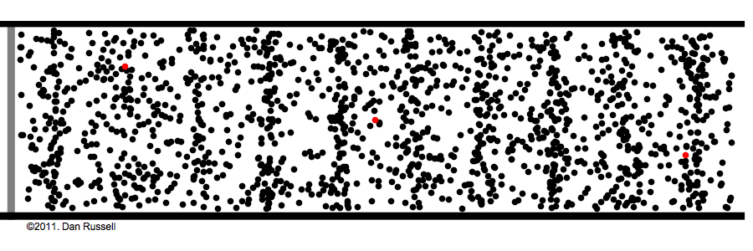
Soundscape fundamentals What is sound?
Sound is the energy transferred when something vibrates in a medium

Slide 4
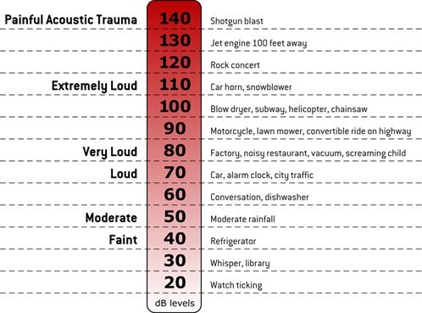
Soundscape fundamentals Sound pressure level

Slide 5
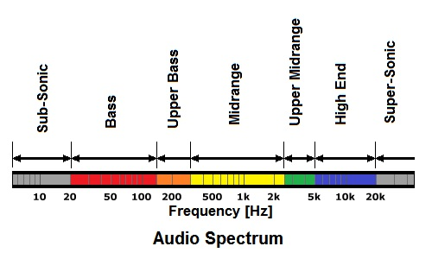
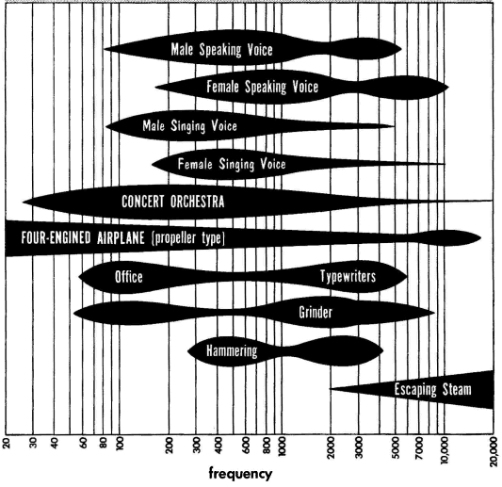
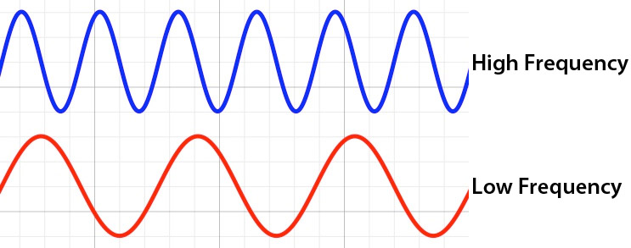
Soundscape fundamentals Audible frequency range
Notes:
Speaker, tube and water: https://www.youtube.com/watch?v=uENITui5_jU

Slide 6
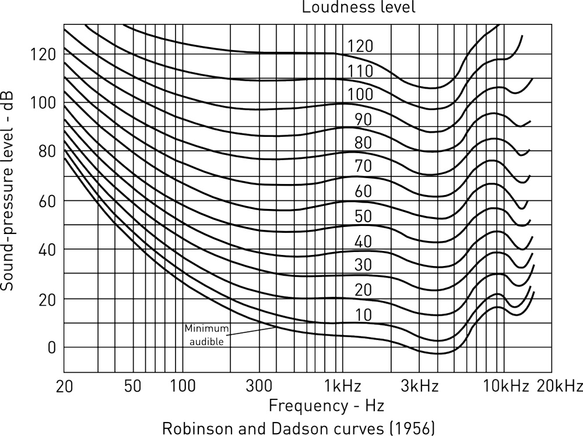
Soundscape fundamentals Equal loudness contours

Slide 7
Soundscape fundamentals Presbycusis - age related hearing loss
Auditory systems sensitivity of high frequency sound degrades over time
Hearing damage also results in high frequency losses
How young are your ears…

Slide 8
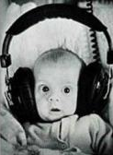
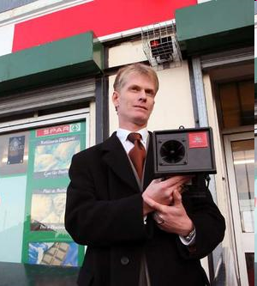
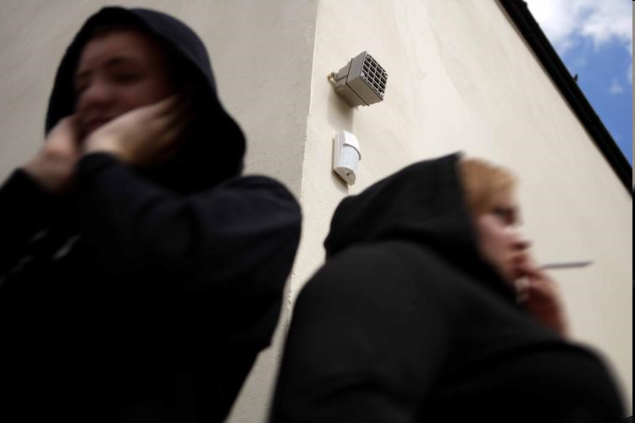
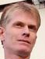

Soundscape fundamentals Presbycusis - age related hearing loss
The evil mosquito anti loitering device

Slide 9
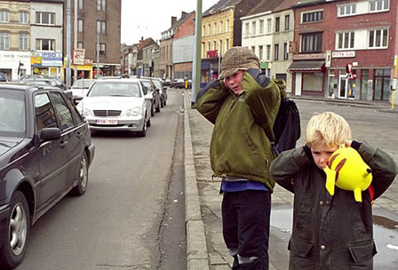
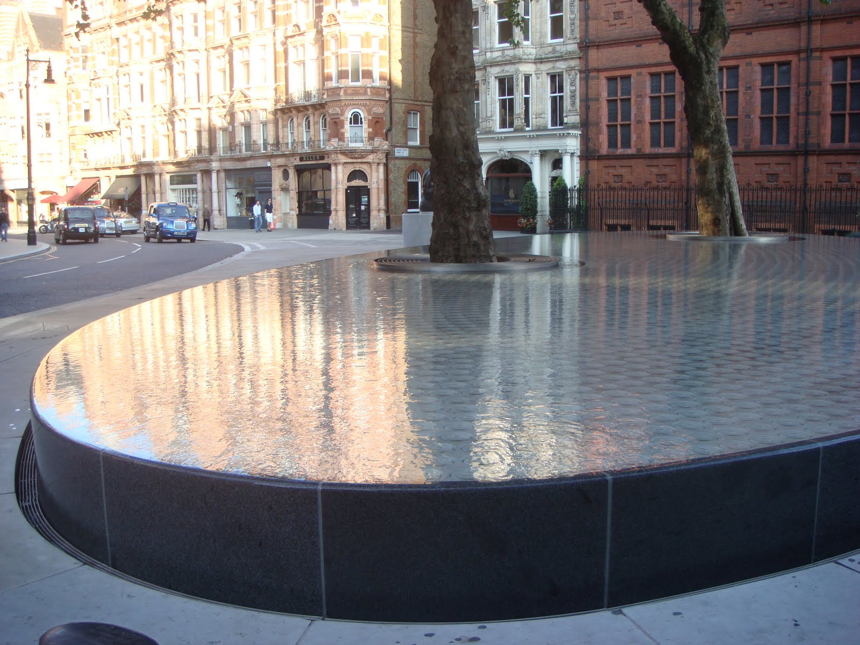
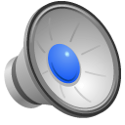
Soundscape fundamentals Masking
Unwanted noise can be masked by more pleasant sounds
Waterfalls/streams are effective at masking traffic noise

Slide 10
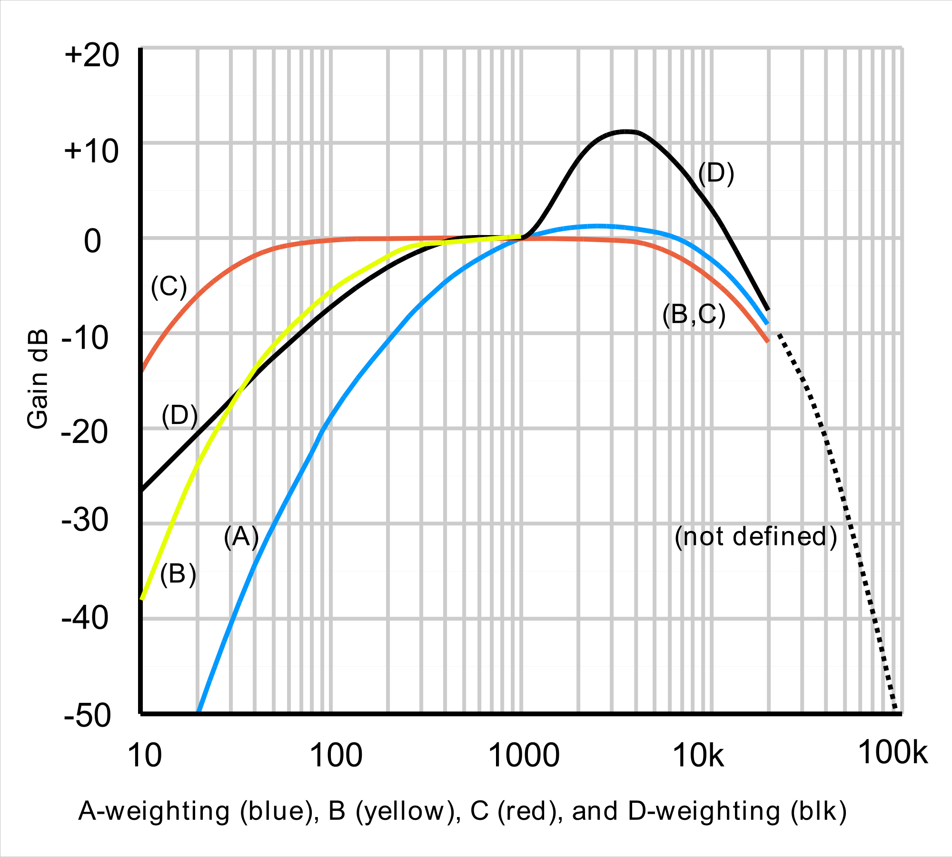
Measuring soundscape data Sound level data – weighted SPL
Human ear more sensitive to frequencies between 500Hz – 8kHz
Urban noise policies rely on the use of A weighted sound pressure level
Approximates the response of the human auditory system
Dated standard
Low frequency noise annoyance isn't accounted for – wind turbine noise

Slide 11
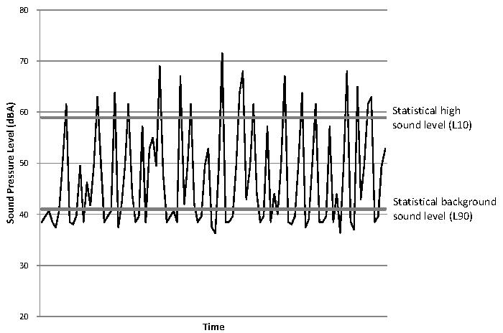
Measuring soundscape data Sound level data – statistical SPL
Quantifies sound pressure level exceeded for n percent of the measurements duration
They make up approximate measures of peak (L1%), intrusive (L10%), median (L50%) and background (L90%) sound levels

Slide 12
Measuring soundscape data Sound level data – LAeq
Equivalent continuous A-weighted sound pressure level
Characterizes fluctuating instantaneous sound pressure levels during a time interval as an equivalent steady state level
Traditionally used as a primary objective indicator in soundscape research because of its ease of measurement and calculation
Correlates reasonably well with perceived loudness and specific annoyance

Slide 13
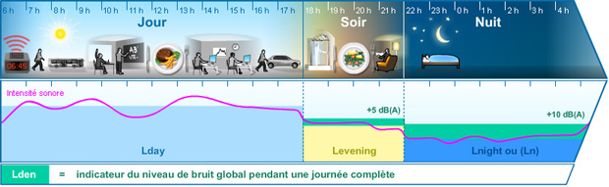
Measuring soundscape data Sound level data – Day, evening, night SPL
Average equivalent sound pressure level over a 24 hour period
Penalty added to measurement to reflect the increased impact of noise at different times of the day
5dB(A) added during the evening hours of 18:00 – 22:00
10dB(A) added during the nighttime hours of 22:00 – 07:00

Slide 14
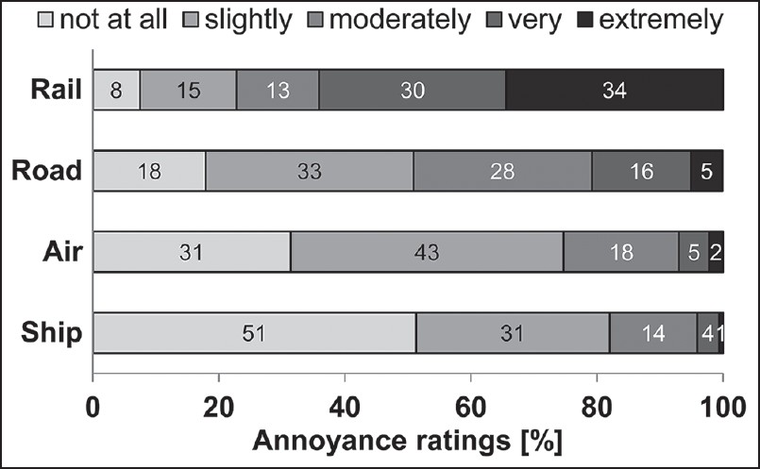
Measuring soundscape data Soundscape evaluation - annoyance
Means of gauging subjective response
Bridging the gap between the physical and social sciences

Slide 15
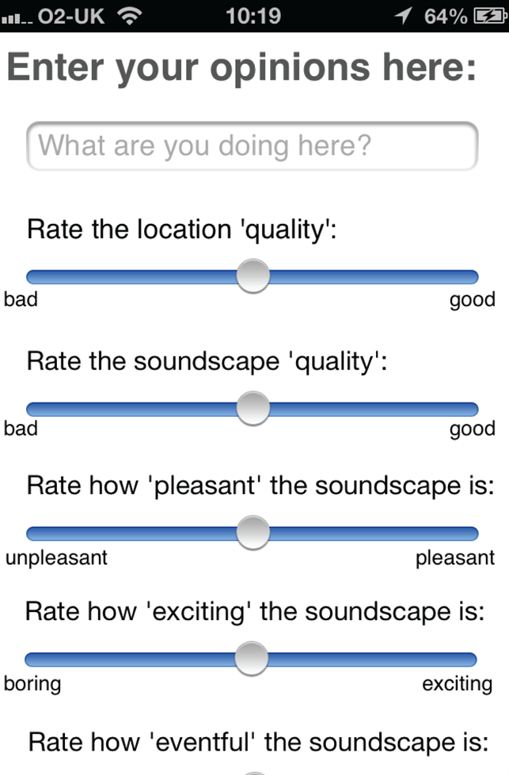
Measuring soundscape data Soundscape evaluation – semantic differentials
Another approach to gauge subjective response to soundscapes
Amenable to unsupervised data collection on mobile devices
Used extensively in complex sound perception experiments
Presents the participant with bipolar semantic descriptors

Slide 16
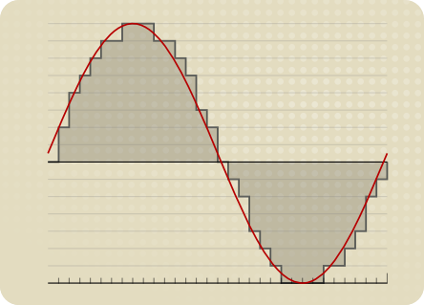
Measuring soundscape data Digital audio data – sampling (ADC)
The reduction of a continuous signal to a discrete signal (sequence of samples)
A sample represents an amplitude in time
The sample rate determines how often a sample is measured in time
CD quality audio is sampled at 44,100 times per second (Hz)

Slide 17
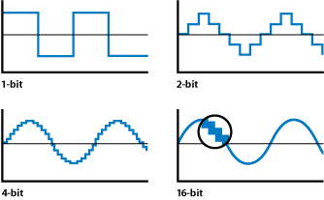
Measuring soundscape data Digital audio data – bit depth
The number of bits of information used to represent each audio sample
CD quality audio uses 16 bits of information per audio sample (0±32768)
Lower bit depths reduce the signal to noise ratio

Slide 18
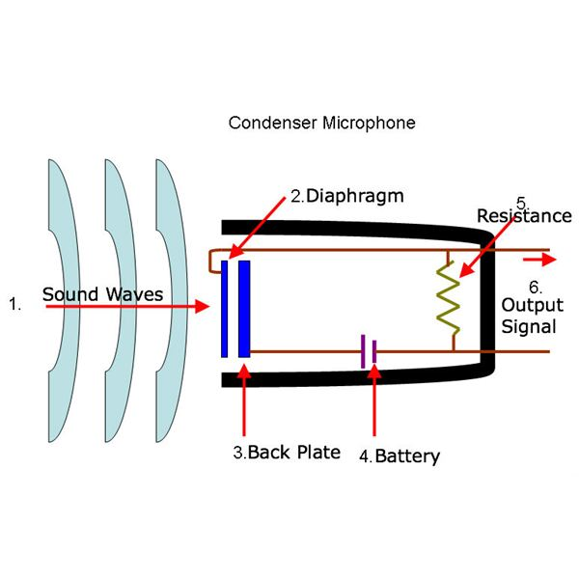
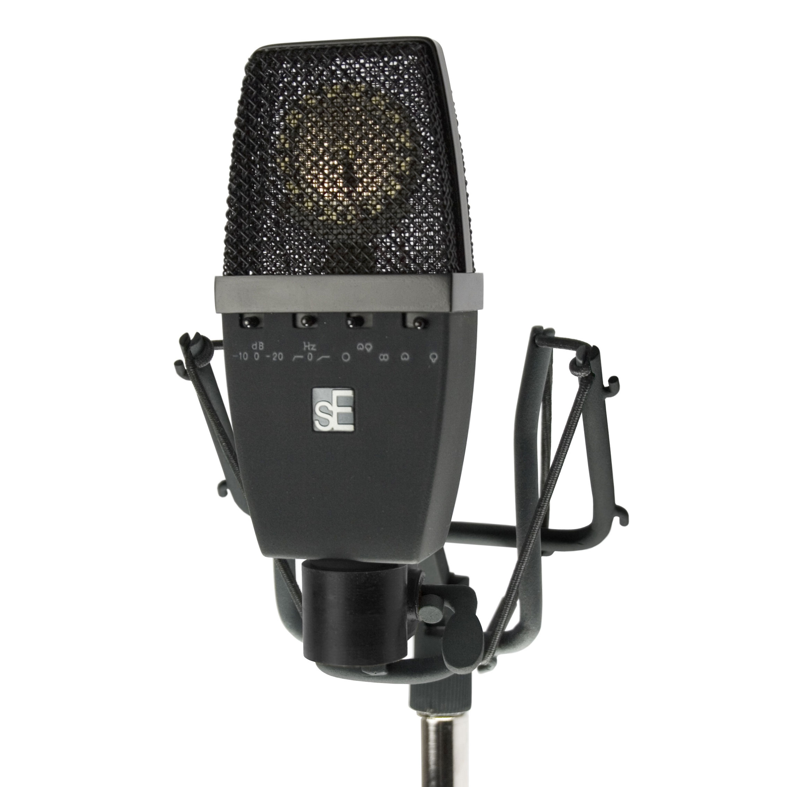
Designing acoustic sensors Microphone types – condenser
The microphone diaphragm acts as a capacitor
As the diaphragm vibrates a varying voltage is generated
This varying voltage is the audio signal
Great for indoor vocal recording
Delicate diaphragm means they aren't very rugged

Slide 19
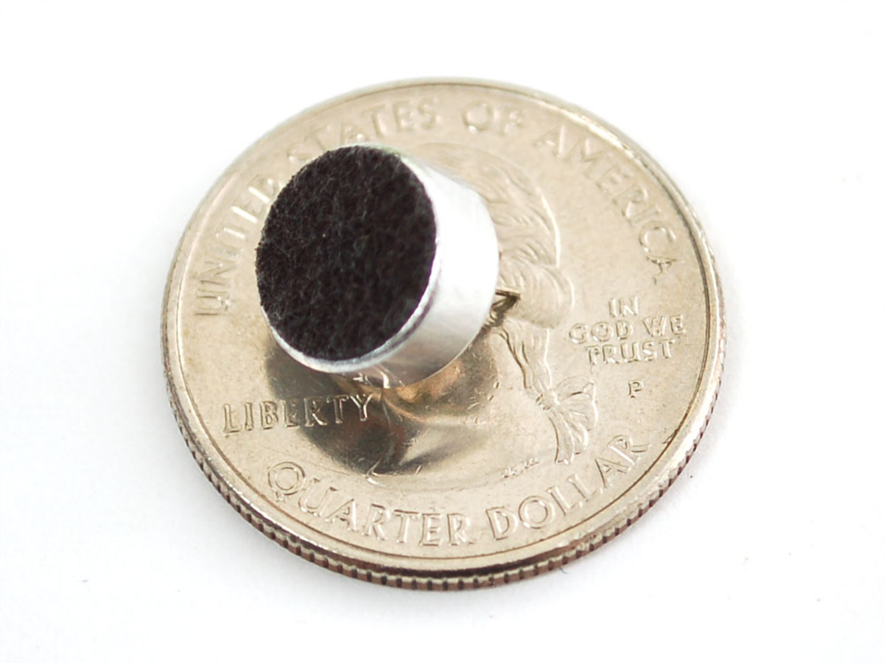
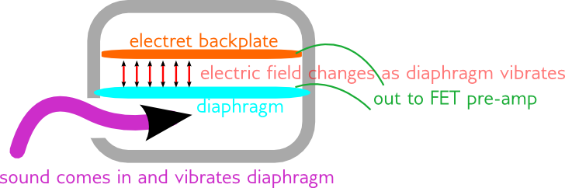
Designing acoustic sensors Microphone types – electret
Uses a permanent electrically charged back plate
Similar process to condenser microphones
Small in size
Low cost
Not very rugged

Slide 20
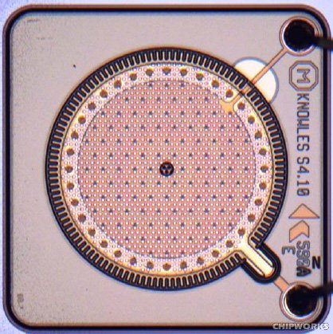
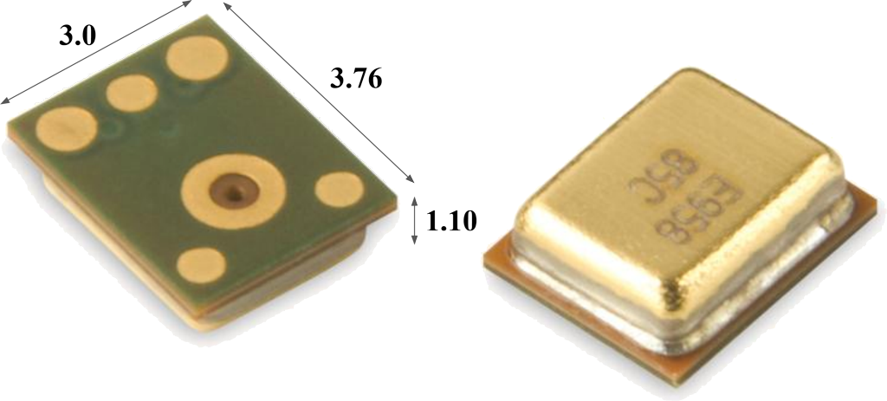
Designing acoustic sensors Microphone types – MEMS
Diaphragm is etched directly onto a silicon chip using Micro Electro Mechanical System techniques
Variants of the condenser microphone type
Extremely small
Very rugged
Very high part to part consistency

Slide 21
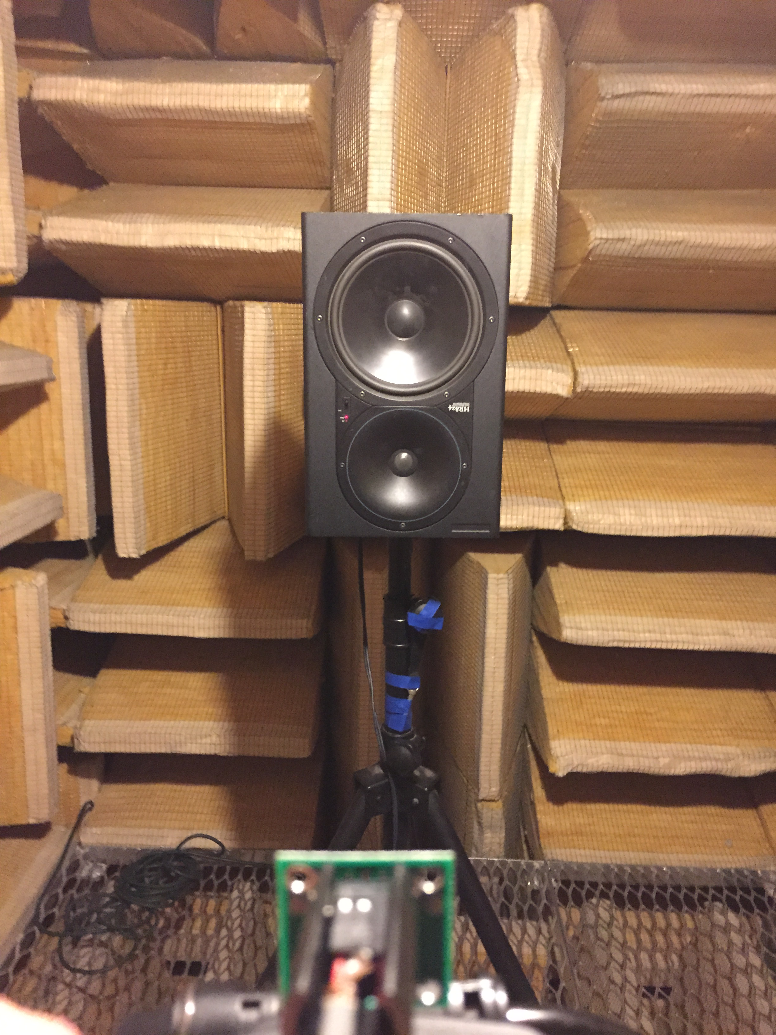
Designing acoustic sensors Microphone characteristics – sensitivity, noise floor, SNR
Sensitivity
The output of a microphone in response to a 1kHz sine wave at 94dB
Determines its ability to pickup quieter sounds
Noise floor
Noise produced by the entire audio system
Signal to noise ratio (SNR)
The ratio of signal power to noise floor power
Performed under anechoic conditions

Slide 22
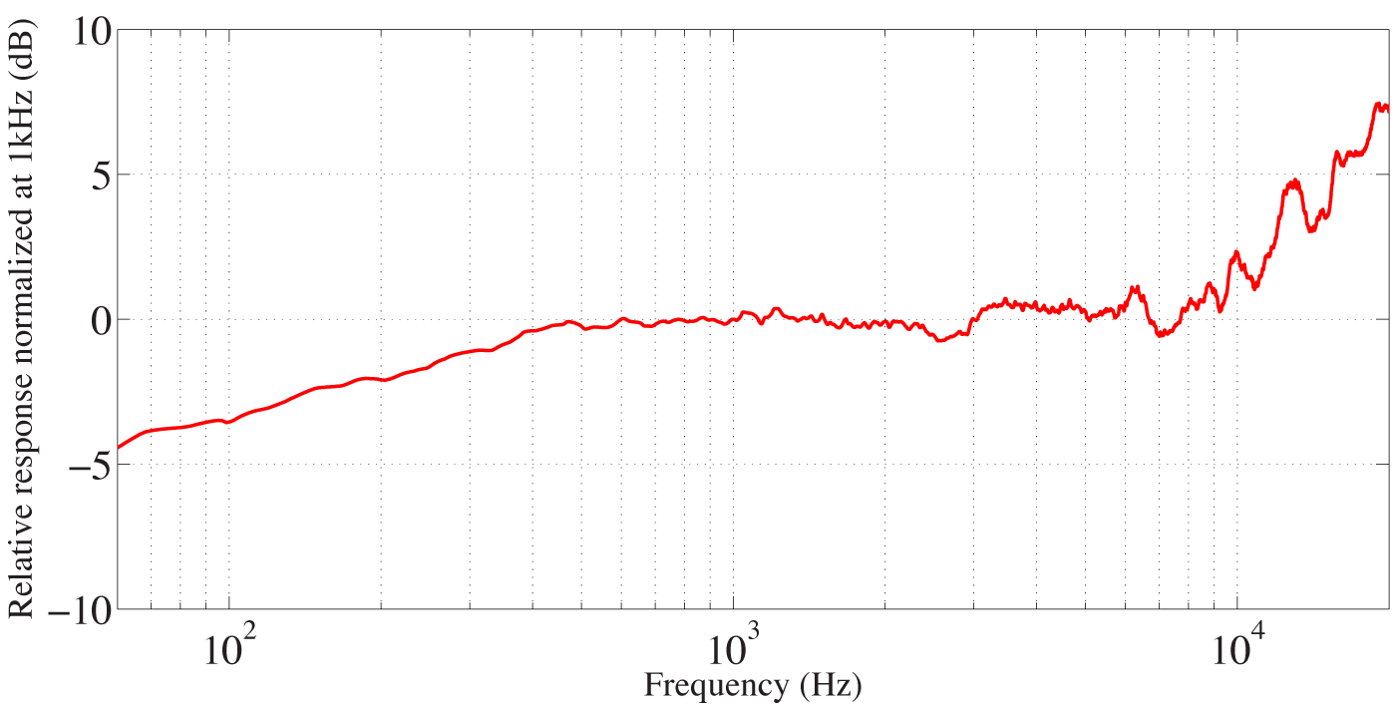
Designing acoustic sensors Microphone characteristics – frequency response
Characterizes a microphone’s sensitivity/output level across the audible frequency range
The project requires as close to a “flat” response as possible

Slide 23

Designing acoustic sensors Calibration – why do we need calibrated data?
Need to be sure of the accuracy of a set of measurements
Involves the generation of a known SPL in comparison to a reference device such as a class 1 sound level meter (SLM)
Policy enforcement requires calibrated data with a given tolerance
American National Standards Institute (ANSI) specify 3 classes of SLM:
0 = laboratory grade (±<1dB)
1 = precision field measurement grade (±1dB)
2 = general purpose measurement grade(±2dB)

Slide 24
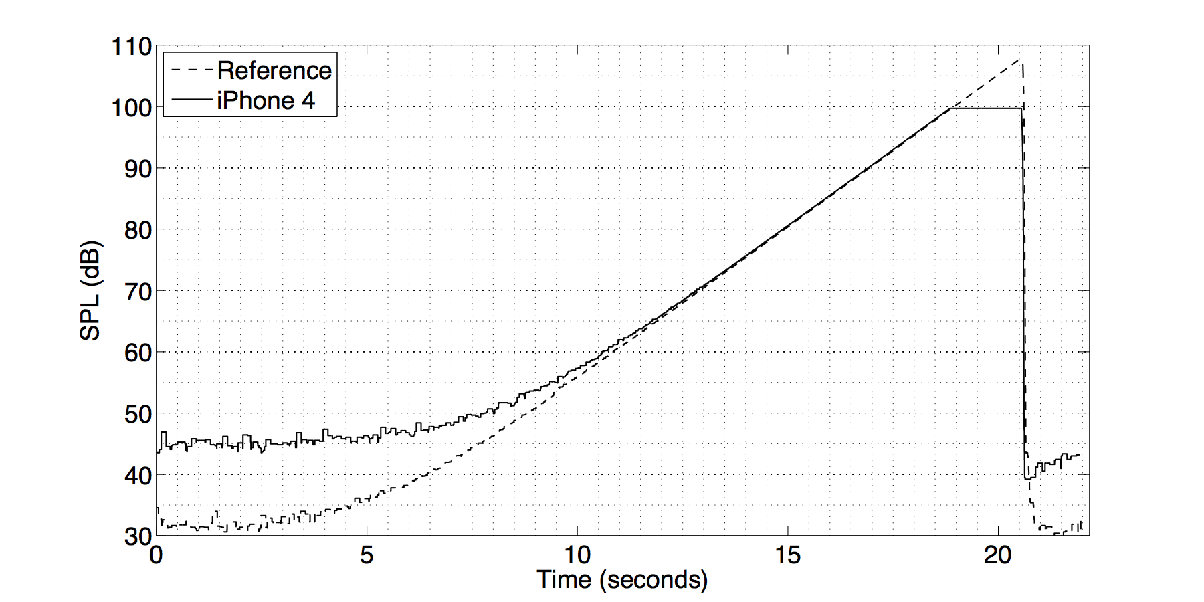
Designing acoustic sensors Calibration – frequency/level response compensation
You need to compare to a calibrated reference device

Slide 25
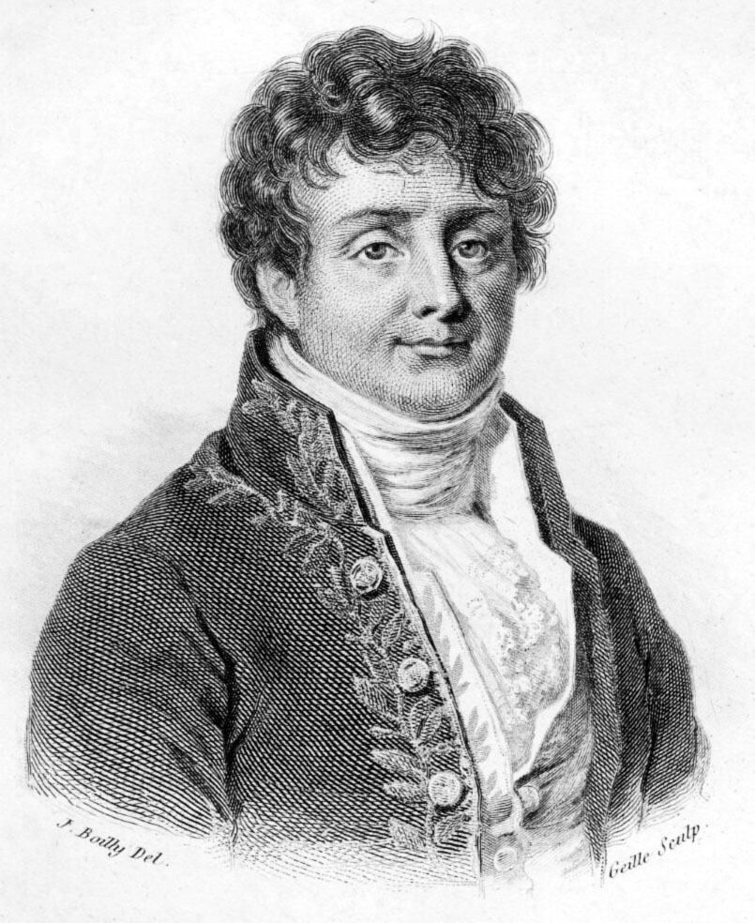
Frequency domain analysis Fourier's Theorem
In 1807, Jean Baptiste Joseph Fourier, a French mathematician and physicist stated that:
Any periodic function can be rewritten as a weighted sum of sines and cosines of different frequencies
This was called Fourier Series and is one of the most important tools in science

Slide 26
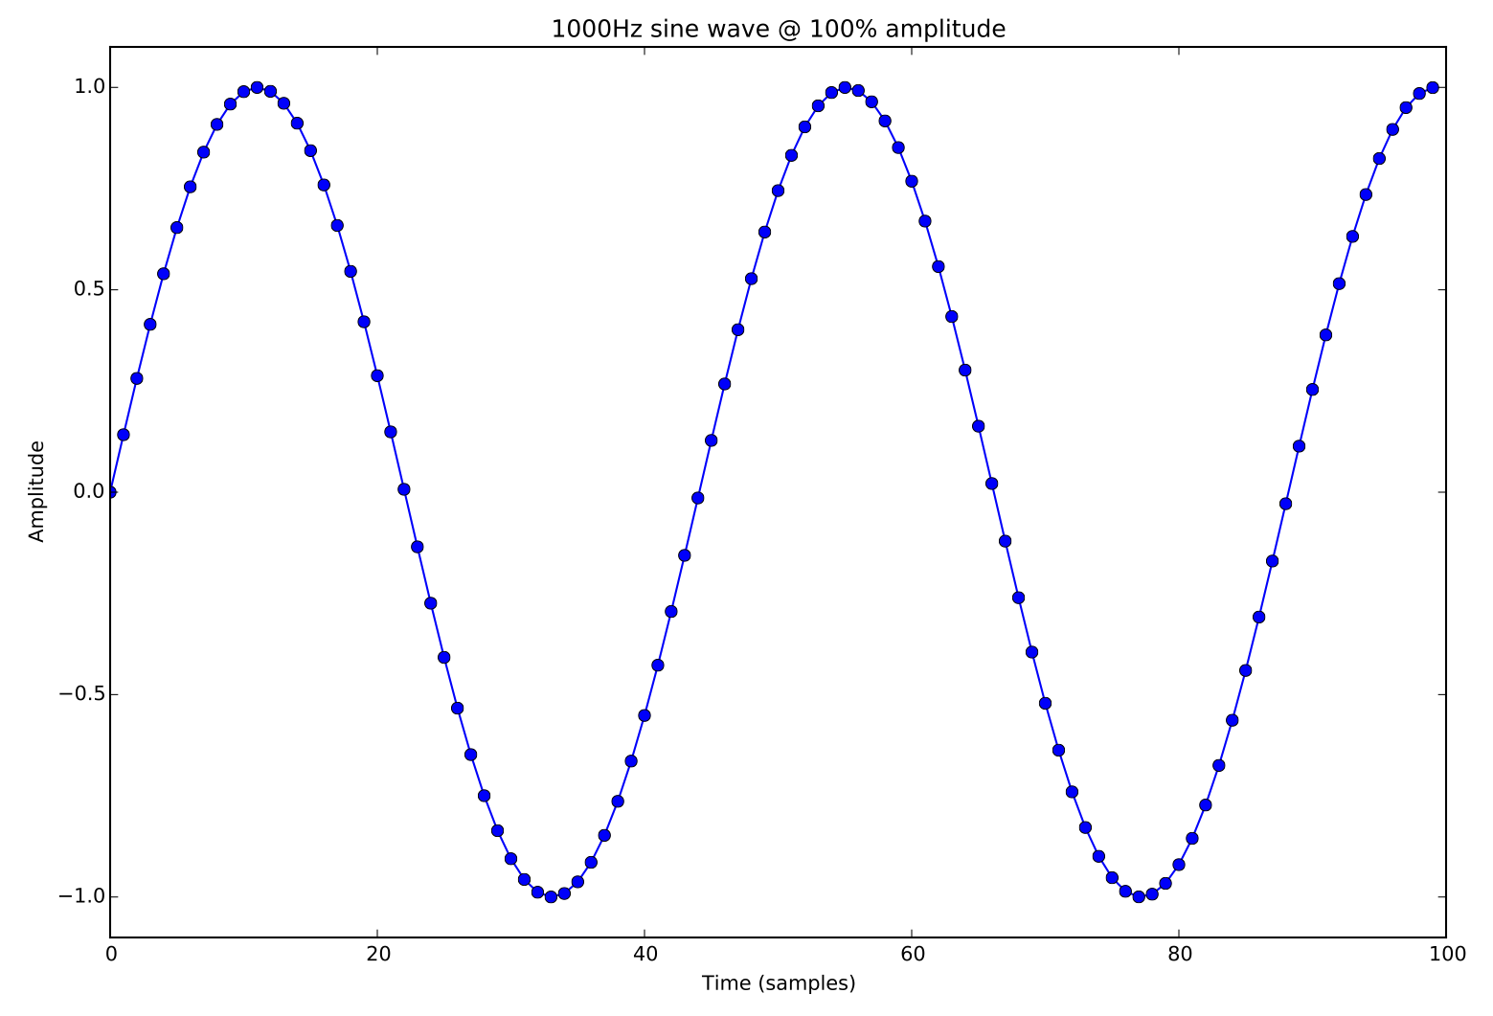
Frequency domain analysis The summation of sinusoids
According to Fourier we can recreate any complex waveform using a weighted combination of the most fundamental audio components:

Slide 27
Frequency domain analysis The summation of sinusoids
According to Fourier we can recreate any complex waveform using a weighted combination of the most fundamental audio components:
phase component
for i in range(sample_len):
sine_samples[i] = A * np.sin(2 * np.pi * freq * T[i])

Slide 28
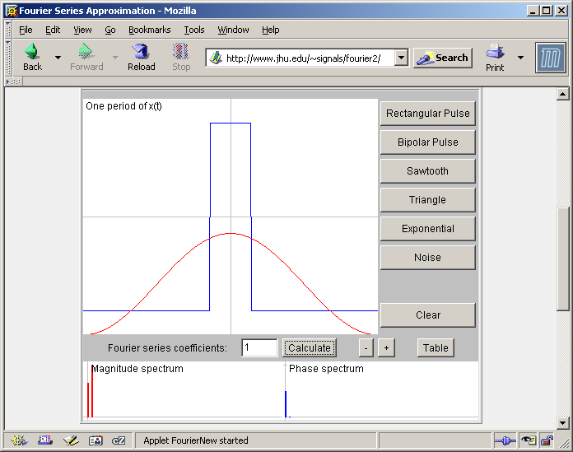
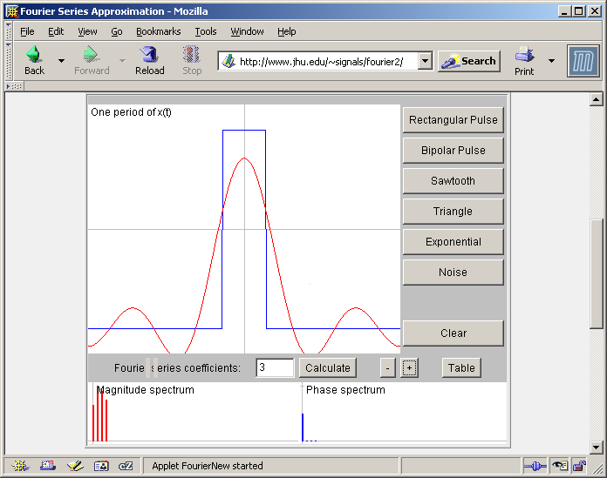
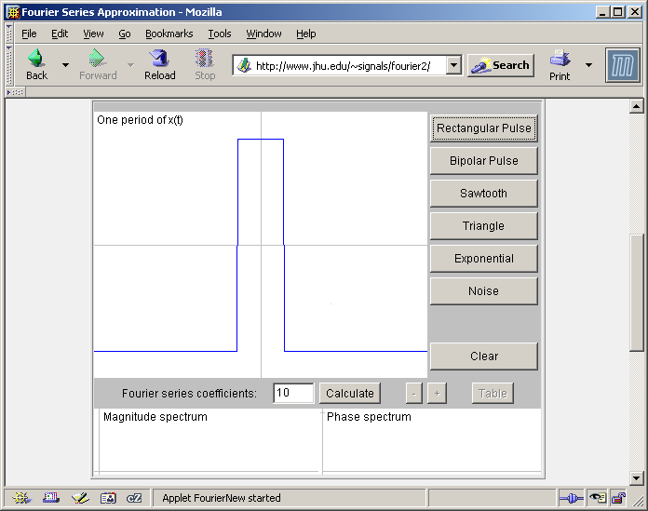
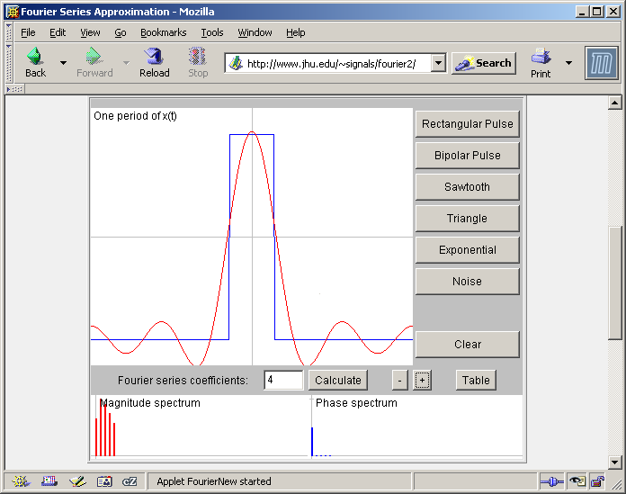
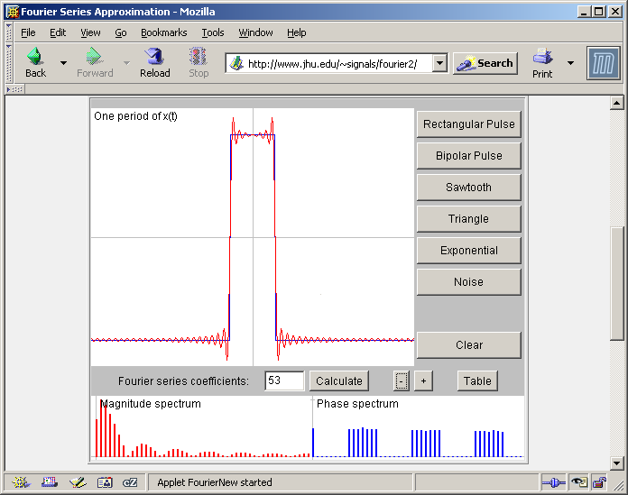
Frequency domain analysis The summation of sinusoids
If you sum an infinite number of weighted sine and cosine waves, you can recreate any complex waveform, such as: human speech, car horn, siren, music, urban soundscapes, etc., etc., etc…

Slide 29
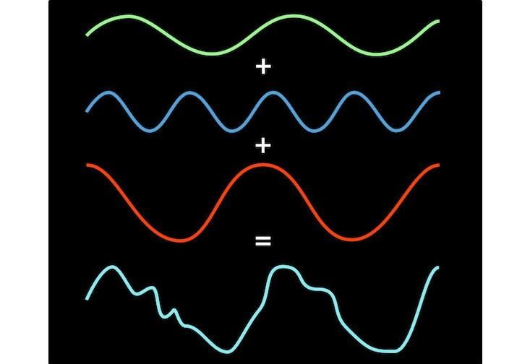
Frequency domain analysis The summation of sinusoids
The sound wave generated by a piano note may look complex, but it is simply a combination of a number of sine waves

Slide 30
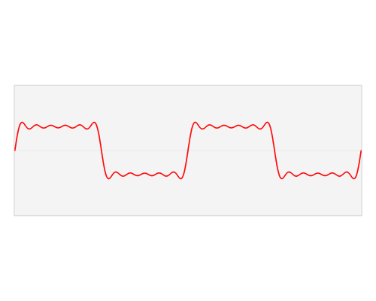
Frequency domain analysis The summation of sinusoids
Take a look at this gif showing the decomposition (and Fourier transform) of a square wave:

Slide 31
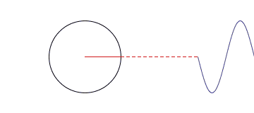
Frequency domain analysis The summation of sinusoids
Thought of in another way, the combination of simple sinusoids can be represented as a set of rotating circles of different sizes, where:
Its size = the sinusoids amplitude
Its rotational speed = the sinusoids frequency

